Slide 1

DTE Goals
DTE strives to deliver an accurate range estimate based on the battery energy and the learned driving behavior.
CEDTE will improve upon this goal by incorporating current weather conditions, traffic, and route input (if available).
Customers are sensitive to DTE step changes, 1:1 ratios between miles driven and miles lost, and consistency over key cycles.
Battery Energy impacted by Life & Temp.
$$DTE=\frac{Battery Energy (Wh)}{Efficiency (\frac{Wh}{km})}$$

Slide 2
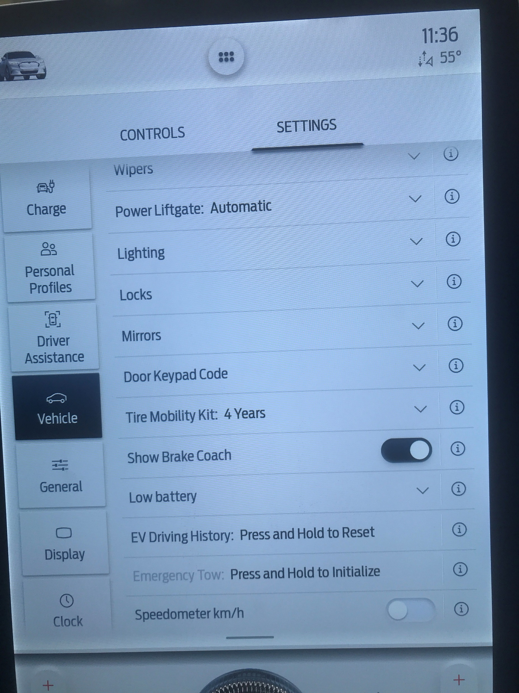

Base DTE Reset
How does it reset?
Settings → Vehicle → EV Driving History
Also automatically triggered by 12V reset.
Note: a Trip Reset in the Trip IoD will NOT reset the DTE.
What does it reset? The learned efficiency.
This will set the learned efficiency used in the DTE equation to a calculated value.
The calculated value is based on two calibrations:
battery size and label range.
Label DTE example
4P AWD label DTE 270 Miles based on 88300Wh/434.5 km → 203.2 Wh/km
4P RWD label DTE 300 Miles based on 88300Wh/482.8 km → 182.9 Wh/km
What happens if the battery energy available changes?
Since the reset is to specific efficiency, a difference in energy results in a different DTE, even at 100% SoC.
Aging batteries or cold climates can cause the DTE after reset to change.
$$DTE=\frac{Battery Energy (Wh)}{Efficiency (\frac{Wh}{km})}$$

Slide 3
